Slide 1

UNIVERSITY INSTITUTE OF ENGINEERING
COMPUTER SCIENCE ENGINEERING
Bachelor of Engineering (Computer Science & Engineering)
Subject Name: Block chain Technology
Subject Code: 20_CST-412
Collision resistant
mapped with CO4
Prepared By:
Er. Ankita Sharma
DISCOVER . LEARN . EMPOWER

Slide 2
For a hash function to be cryptographically secure, we require that it has the following three additional properties:
Collision Resistant
Hiding
Puzzle friendliness

Slide 3
A collision occurs when two distinct inputs produce the same output.
A hash function ​ H(.) ​ is collision‐resistant if nobody can find a collision.

Slide 4
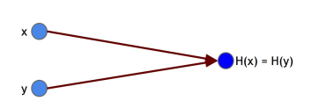
Formal Definition
A hash function​H​is said to be collision resistant if it is infeasible to find​​ two values, ​ x​and ​ y​ , such that ​ x ​ ≠​​ y​ , yet ​ H(x)​ =​ H(y) .

Slide 5
Notice that we said ​ nobody can find ​ a collision, but we did not say that no collisions exist.
The input space to the hash function contains all strings of all lengths, yet the output space contains only strings of a specific fixed length.
Because the input space is larger than the output space (indeed, the input space is infinite, while the output space is finite), there must be input strings that map to the same output string.
In fact, by the Pigeonhole Principle there will necessarily be a very large number of possible inputs that map to any particular output.

Slide 6
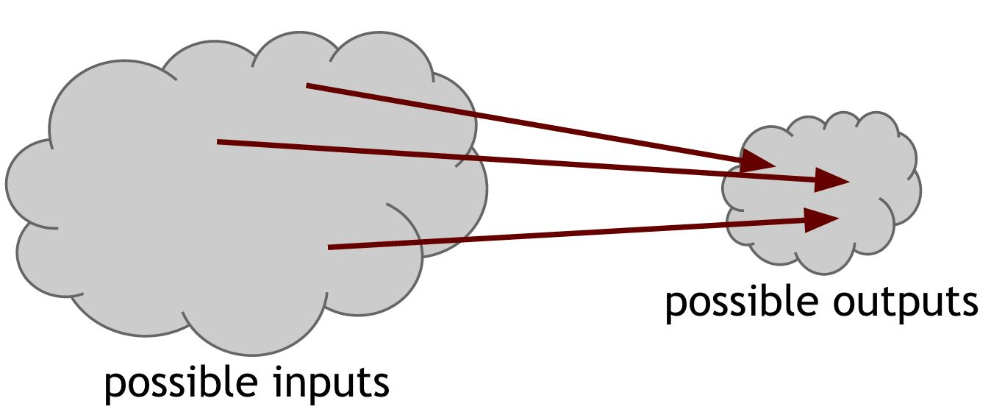
There are methods that are guaranteed to find a collision.
Consider the following simple method for finding a collision for a hash function with a 256‐bit output size: pick 2​ 256​+ 1 distinct values, compute the hashes of each of them, and check if there are any two outputs are equal.
Since we picked more inputs than possible outputs, some pair of them must collide when you apply the hash function.

Slide 7
The good thing is that it takes a very, very long time to do find two input with same hash/output.
For a hash function with a 256‐bit output, you would have to compute the hash function 2​^{256 ​ + 1} times in the worst case, and about 2​¹²⁸ ​ times on average.
That’s of course an astronomically large number — if a computer calculates 10,000 hashes per second, it would take more than one octillion (10​²⁷​ ) years to calculate 2​^{128 ​}hashes
MD5 hash function, collisions were eventually found after years of work, leading the function to be deprecated and phased out of practical use.

Slide 8
Application: Message digests
What is collision‐resistance useful for?
This property allows us to use hash outputs as a ​message digest.
​Consider SecureBox, an authenticated online file storage system that allows users to upload files and ensure their integrity when they download them.
Problem: “Suppose that Alice uploads really large file, and wants to be able to verify later that the file she downloads is the same as the one she uploads. One way to do that would be to save the whole big file locally, and directly compare it to the file she downloads. While this works, it largely defeats the purpose of uploading it in the first place; if Alice needs to have access to a local copy of the file to ensure its integrity, she can just use the local copy directly.”

Slide 9
Solution: “Alice just needs to remember the hash of the original file. When she later downloads the file from SecureBox, she computes the hash of the downloaded file and compares it to the one she stored. If the hashes are the same, then she can conclude that the file is indeed the one she uploaded, but if they are different, then Alice can conclude that the file has been tampered with.”

